Slide 1
Assessing Impact of NFL Defensive Lineman Using Pre-snap Technique Position
SIS Football Analytics Challenge – July 2020
Russell Ivanac
@RussIvanac

Slide 2
Premise and Initial Assumptions
General premise: For a given play, a good outcome for the defense is when the offense becomes less likely to score points. The less likely, the better.
Defense is a group effort and therefore relying solely on individual statistics potentially overlooks the positive or negative impact a player has on a play
Therefore, the most valuable defensive line position is the one who most contributes to limiting the offense’s likelihood of scoring points with their presence
For this analysis, defensive line positions were classified by their pre-snap technique position, identified by the side of the line and gap in which they were positioned
17 defensive line positions (denoted as L9, L7, L5, etc.)
Technique variations, such as 4i and 4 or 2i and 2, were combined
Only snaps taken at a defensive line position were considered

Slide 3
Play Outcomes and Evaluation Metrics
Each play result was classified as a “Bad” or “Good” outcome for the defense, based on the categories below and were classified in descending order of priority
Bad Outcomes
Offensive Touchdown
Offensive 1st Down
Positive EPA
Good Outcomes
Safety
Sack Fumble
Sack, Fumble, Interception
Negative Yardage
Negative EPA
Excluded
Kneel
Spike
Converted to a percentage of total plays, the Good/Bad Outcome Percentage was used alongside EPA as an evaluation metric throughout this analysis

Slide 4
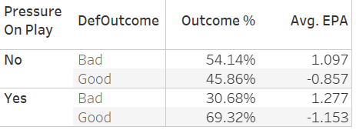
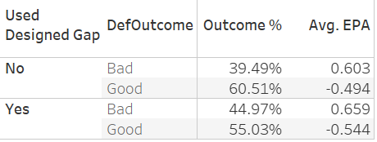
Impact of QB Pressure and Designed Run Gap
While not a play result, the impact of pressuring the QB or forcing the rusher to use a gap other than what was intended cannot be overlooked
Forcing the offense out of their initial plan improves a defense’s Good Outcome Percentage and average EPA
This impact is more significant when pressure is applied, so this analysis will put more emphasis on pressure
23.46% improvement in Outcome Percentage, and a 0.608 expected difference in Avg EPA (all outcomes)

Slide 5
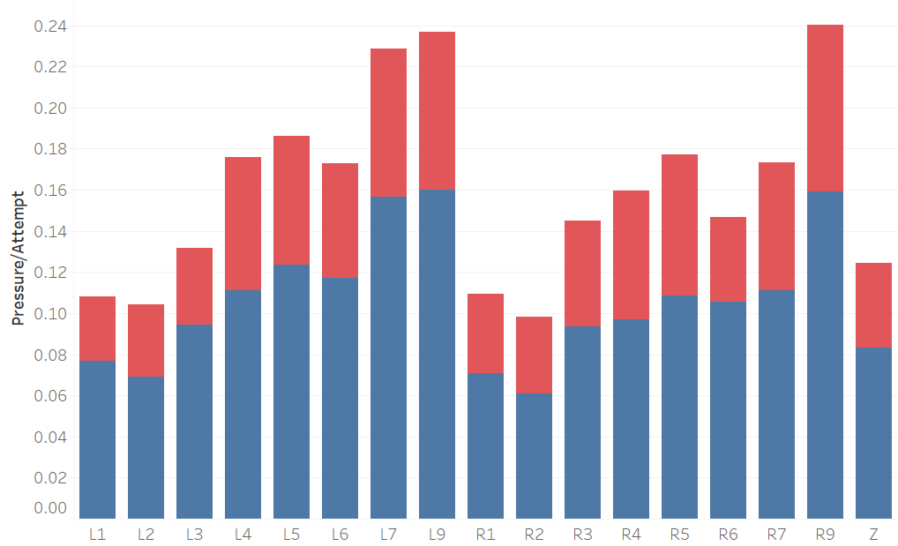
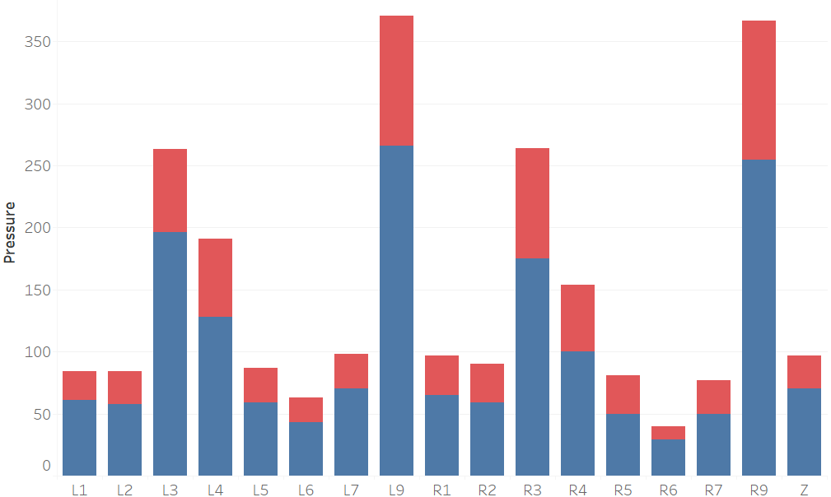

Pressures by DL Technique Position
Pressure per pass rushing attempt by DL Technique Position
Total pressures by DL Technique Position
The large majority of QB pressures come from the L9 and R9 Technique position, however when viewed on a per pass rushing attempt basis, the gap is lessened considerably
L9 and R9 are sent after the QB more often than any other Technique Position, but they also successfully pressure the QB at a higher rate than other DL Technique Positions

Slide 6
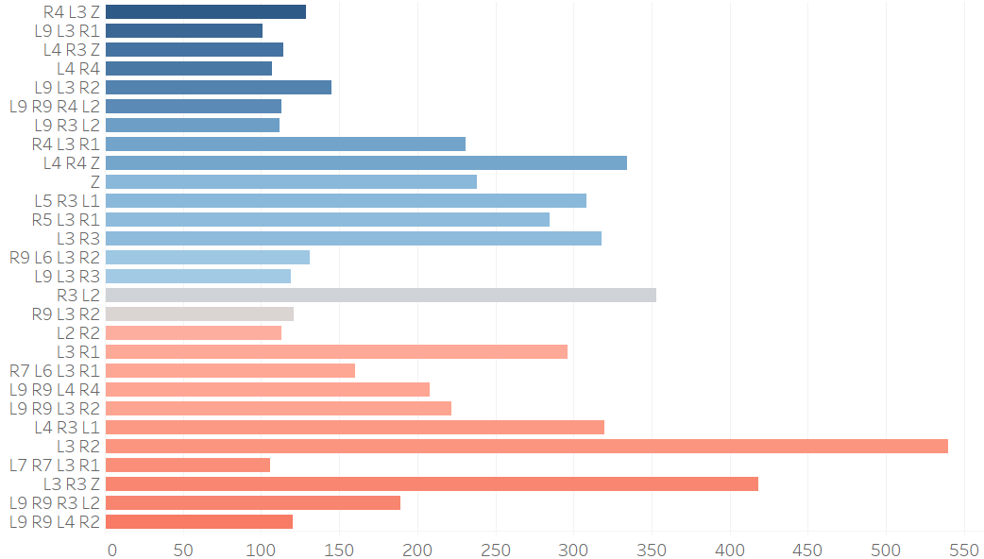
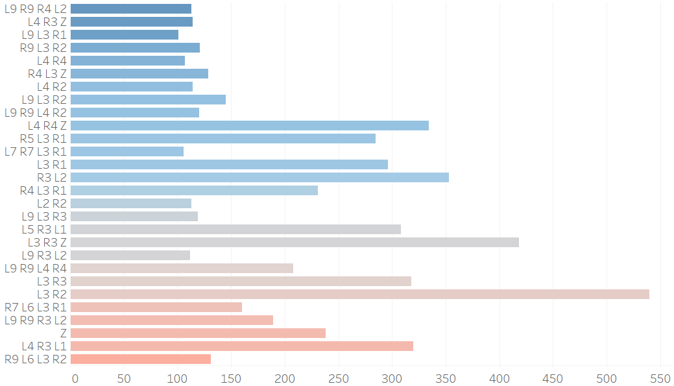


Formations and relation to Tech Positions
DL Combinations, sorted by Defensive Outcome Percentage when combination was used (min 100 plays)
DL Combinations, sorted by average EPA when combination was used (min 100 plays)
L3 appears most frequently of all DL Technique Positions in the top 20 DL combinations for Outcome Percentage (55%), and Average EPA (50%). However, it is generally the most frequently used DL Technique Position, and appears in 60% of the 20 most frequently used DL combinations for reference
L9 and R4 each appear in 25% or more of the top 20 DL combination for Outcome Percentage and Average EPA, while appearing in 25% or less of the 20 most frequently used DL combinations

Slide 7
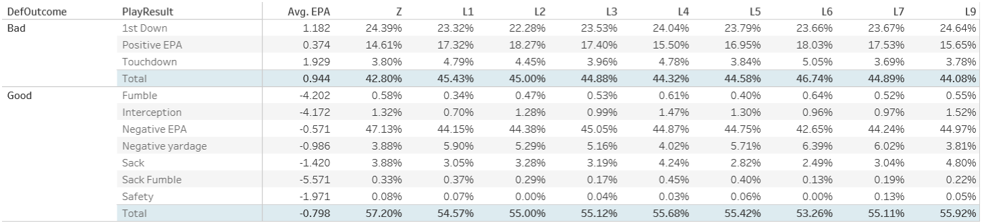
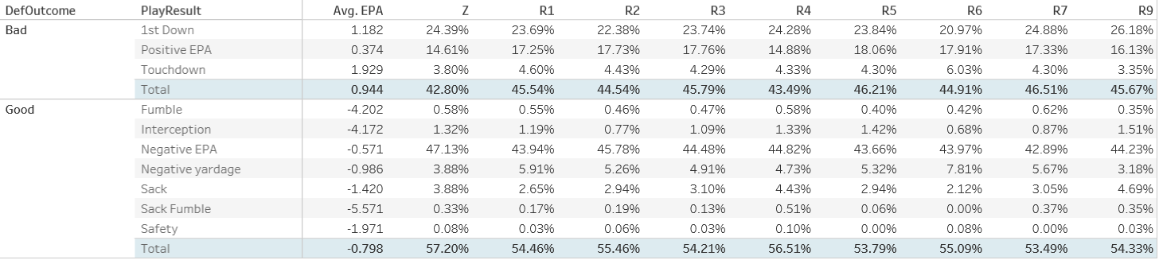
Play Outcome Tables
EPA displayed as average across all plays and formations
Each column represents splits for when a player lines up in that technique position for a play

Slide 8
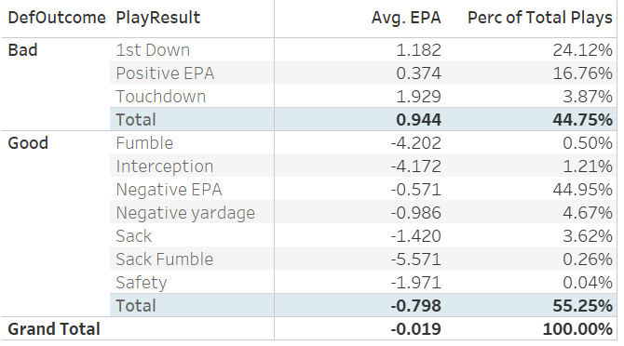
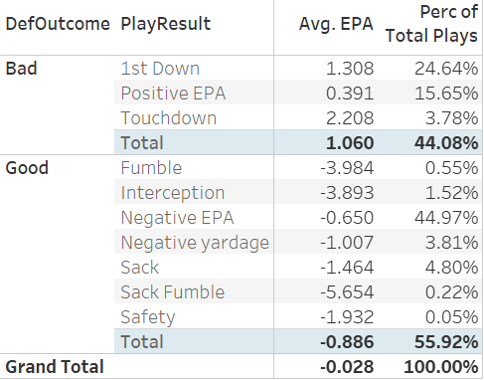
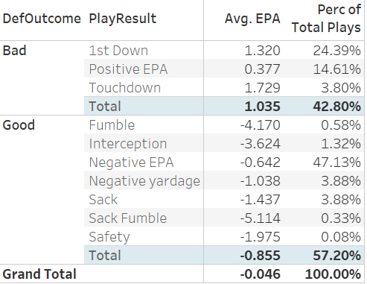
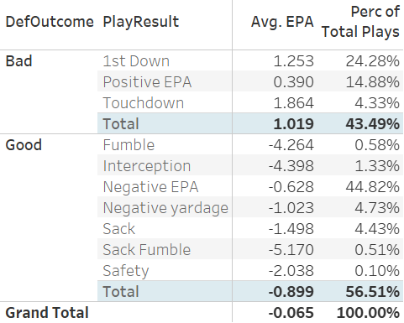
Technique Position Play Outcome Tables
DL Technique Positions with average EPA and Good Outcome Percentage above the average baseline: L9, L5, L4, Z, R2, R4
Highest Net Average EPA: R4 (-0.065)
Highest Good Outcome Percentage: Z (57.2%)
L9
Z
R4

Slide 9
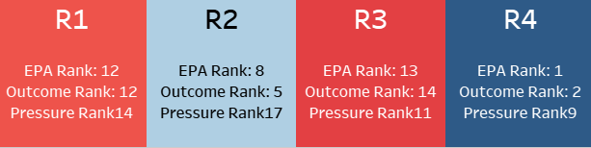
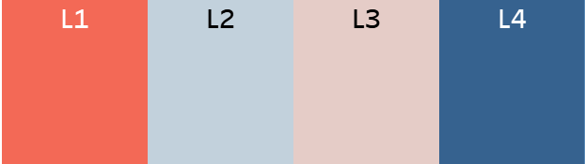
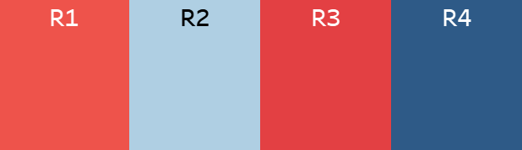
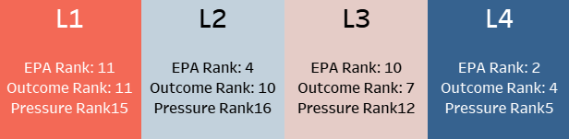
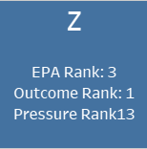

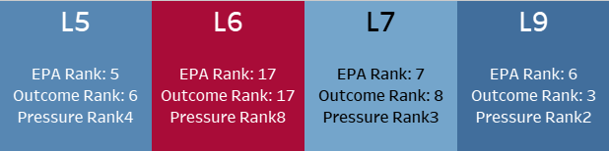
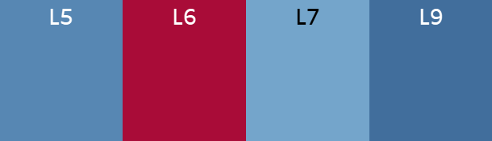
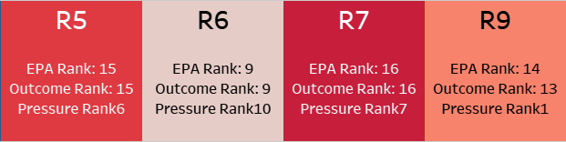
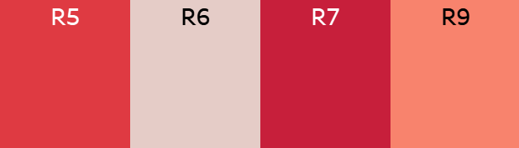
Which is the most valuable defensive line position?
1
The most valuable defensive line position is the one who most contributes to limiting the offense’s likelihood of scoring points with their presence
R4 the most valuable because it has the best weighted rank among DL Technique Positions
Weighted rank puts twice the weight on EPA and Outcome ranks compared to Pressure per attempt rank

Slide 10
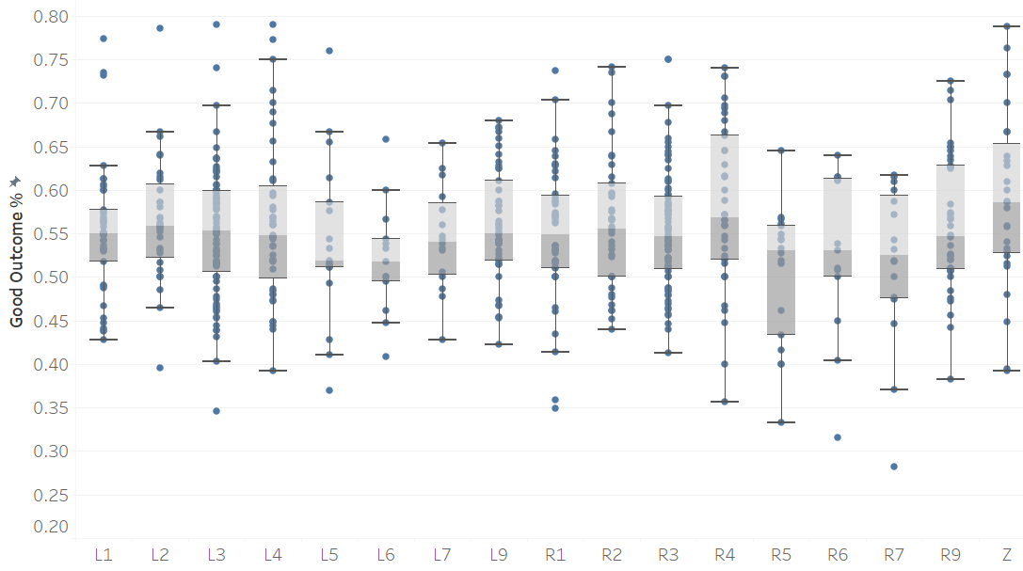
Distribution of talent between the defensive line Technique Positions? (Outcome Percentage)
2
Most positions have a relatively narrow band of talent distribution with little separation between the elite and above average in most cases
Minimum threshold of 25 snaps at a specific defensive line position for consideration. Based on 10% of snaps for 50th percentile player of DL snaps

Slide 11
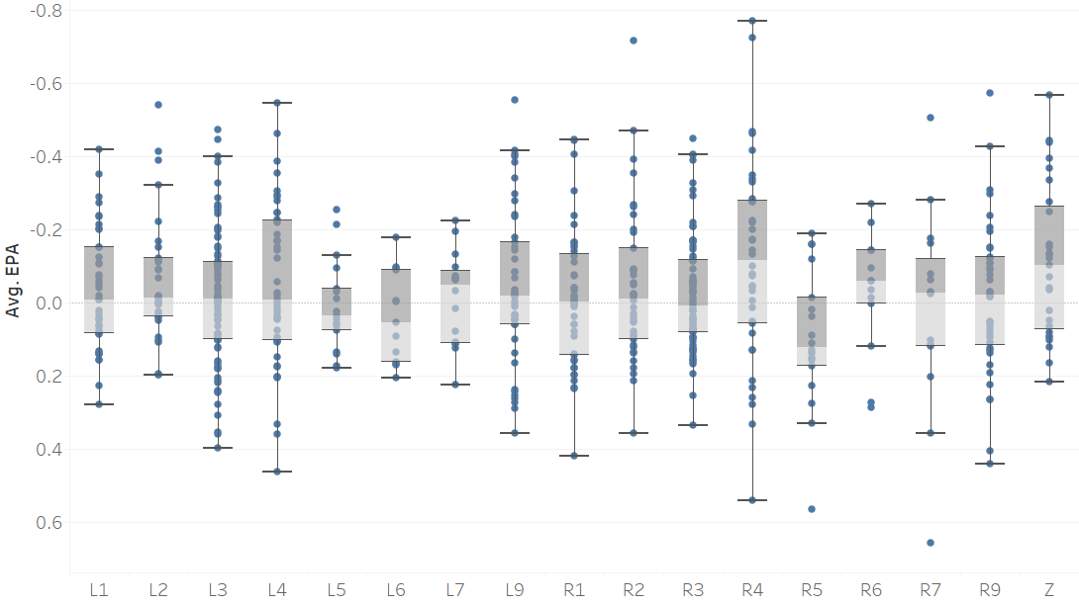
Distribution of talent between the defensive line Technique Positions? (Average EPA)
2
Separation between elite and above average talent is more prevalent than it was for Good Outcome Percentage
Minimum threshold of 25 snaps at a specific defensive line position for consideration. Based on 10% of snaps for 50th percentile player of DL snaps

Slide 12
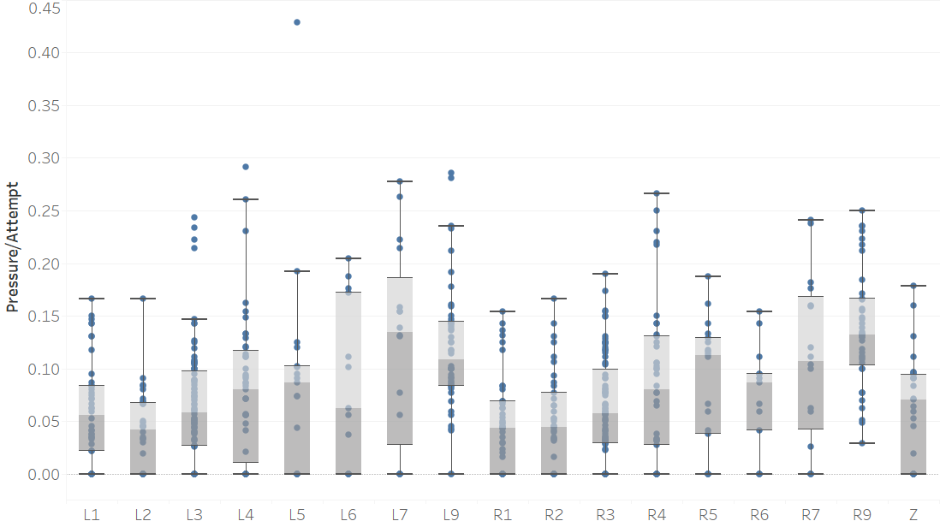
Distribution of talent between the defensive line Technique Positions? (Pressure per Attempt)
2
Certain positions (L9 & R9) consistently show a higher talent for creating pressure than other Technique Positions. Elite members of R4 compare favorably to any other position
Minimum threshold of 25 snaps at a specific defensive line position for consideration. Based on 10% of snaps for 50th percentile player of DL snaps

Slide 13
Which scenarios change the most valuable DL position?
3
Scenario: When the defense’s team is losing
R4’s Outcome Rank falls to 3th (from 2nd) and EPA Rank falls to 2nd (from 1st)
The Z DL Technique Position moves in to the top rank for both
Scenario: On an obvious passing situation
R4’s Outcome Rank falls to 3th (from 2nd) while EPA Rank remains 1st
The L9 DL Technique Position moves to 2nd in Outcome Rank and 3rd in EPA Rank
L9’s higher Pressure Rank takes on more importance when there is no need to defend the run

Slide 14
Limitations and Future Analysis
Limitations
A larger dataset allows for player-level analysis, including individual player talent evaluation at multiple DL Technique Positions
No clear way to deal with role-specific specialists. Not clear with small amount of data low number of snaps were due to role or other factors. Would need to consider impact of replacement player entering the game when specialist leaves
No ability to evaluate quality of competition to add context to defensive performance. A small sample of data is more susceptible to variation of opponents
Additional Data that could enhance analysis
Spatial Tracking data. Could account for movement post-snap and effective gap coverage (stunts, misdirections, etc.) as well as proximity to ball
Corresponding data on offensive counterparts. Consideration of offensive formation and number of blockers, as well as deployment of these blockers would give further context to defensive analysis as well as the ability to look at quality of competition
Data for the remaining defenders on the field. No sight on coverage of secondary, potential blitzing of corners, etc. This would add additional context

